Slide 1
Main Point: Mark 3:35
“For whoever does the will of God, he is my brother and sister and mother.”
Mark 3

Slide 2
The Movement of Jesus and His Followers
Main Point: Mark 3:35
“For whoever does the will of God, he is my brother and sister and mother.”
Mark 3

Slide 3
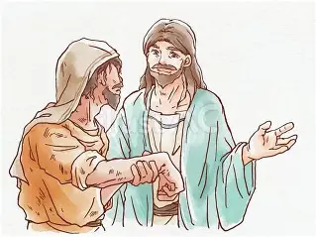
Mark 3:1-6
Setting: In the
Synagogue
v. 4 When Jesus asks, “Is it lawful…”, to which law is He referring?
v. 5 By what action did Jesus heal the man’s withered hand?

Slide 4

Mark 3:7-12
Setting: By the sea
v. 8 What caused
a great multitude
to come to Jesus?
Application:
v. 5 By what action did Jesus heal them?

Slide 5
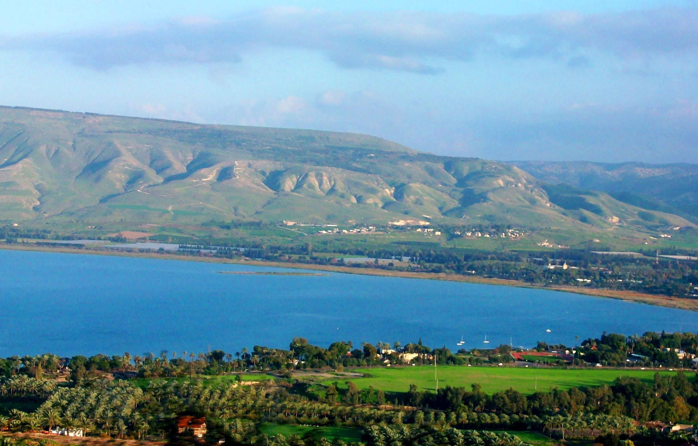
Mark 3:13-19a
Setting: On the mountain
v. 13-15 Describe the relationship between Jesus and the appointed twelve.

Slide 6
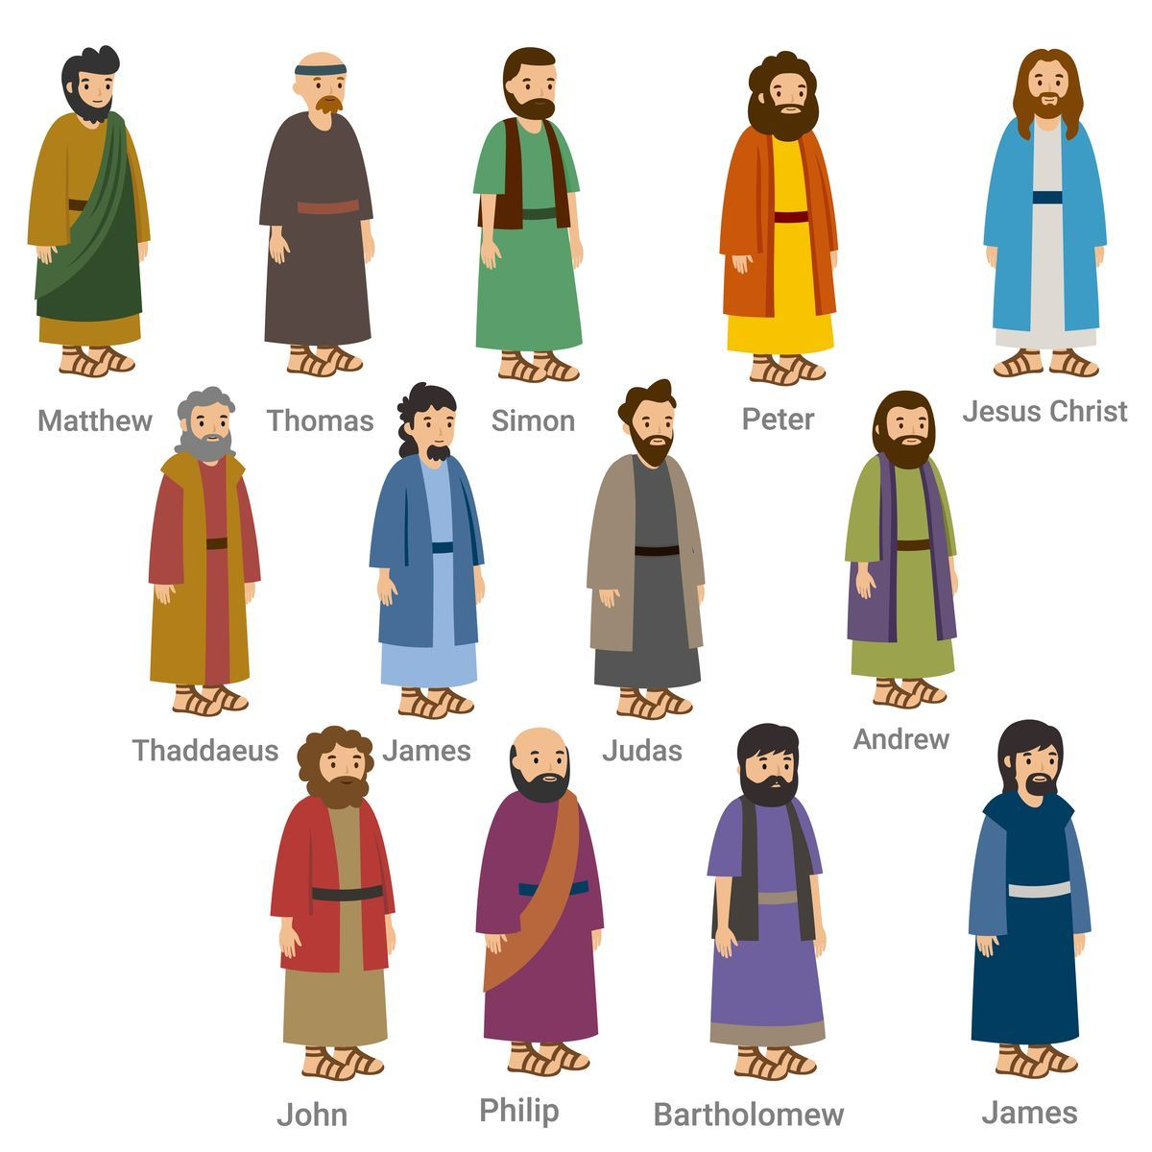
The Twelve Disciples
v. 16-19 Named also in Matthew 10:2-4;
Luke 6:14-16; and
Acts 1:13-26.
Which name is always listed first? last?
What makes Acts unique?

Slide 7
Mark 3:19b-35
Setting: In the house
v. 21 Please read Mark 3:21 in several different translations. I recommend biblegateway.com and put Mark 3:21 in the search box. Once displayed, you should see underneath the verse underlined Mark 3:21 in all English translations – click on it.

Slide 8
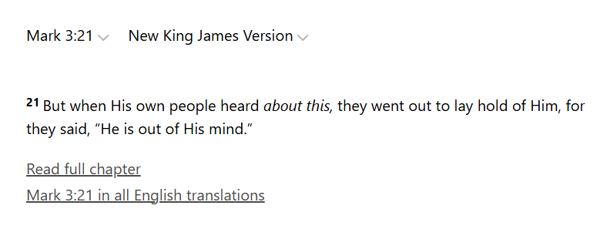
biblegateway.com

Slide 9
Who talking? | What do they say about Jesus?

Slide 10
v. 22 Who or what were the scribes?
(Mark 1:22 provides information about scribes.)
v. 22 What were the scribes saying about Jesus? Why is this important?
The end of Mark 3:30 explains Mark 3:20-22. Explain.

Slide 11
v. 28-29 What is the difference between blasphemies and blasphemy against Holy Spirit?
v. 29 What Spirit did Jesus have? Write what the Bible teaches of the Holy Spirit.
• Isaiah 11:2
• Acts 1:8
• Romans 8:11
• 2 Peter 1:20-21

Slide 12
v. 35 Who does Jesus consider to be His brother and sister or mother?
Application:

Slide 13
APPLICATion:
TELL PEOPLE ABOUT JESUS!
DO THE WILL OF GOD!
AND…

Slide 14
The Movement of Jesus and His Followers
Main Point: Mark 3:35
“For whoever does the will of God, he is my brother and sister and mother.”
Mark 3

Slide 15
MaRK 3 ALLITERATION
“S – D”
Synagogue Man’s Disability
Sabbath Day Healing
Secret Plan to Destroy
Seclusion with Disciples
Selection of the Dozen
Scribes Denouncement
Satan’s Kingdom Divided
Strong Man Detained
Sin’s Danger
Sacred Family Declared

Slide 16
MaRK 3 ALLITERATION
“B”
Beginning of the Chapter
Breaking of Tradition of Sabbath
Boat by the Sea
Beyond the Jordan, They Came
Beside Him to Touch Him
Being Forbidden from Telling
Bunch of Men Chosen and Ordained
Betrayal from Within
Bread not Eaten
Beside Himself/ Crazy
Beelzebub
Bind the Strong Man
Blasphemy Against Holy Spirit
Brothers and Sisters and Mother

Slide 17
MaRK 3 ALLITERATION
“P”
Public Display of His Power
Peace Held by Accusers
Pharisees and Herodians
Plot to Destroy
Private Moment With Disciples
Places, More Places
Pressing In Upon Him
Plagues are Healed
Prevention of Proclamation
Preachers Ordained
Power Distributed
Peter and the Disciples
Person Who Betrayed Him
People Who Used to Know Him
Prince of the Devils
Parable by Jesus
Purpose is Division
Procedure for Binding Strong Man
Person of the Holy Spirit
Parent and Siblings Approach
People Who are Mine
Particulars for Being in the Family

Slide 18

Q & A

