Slide 1
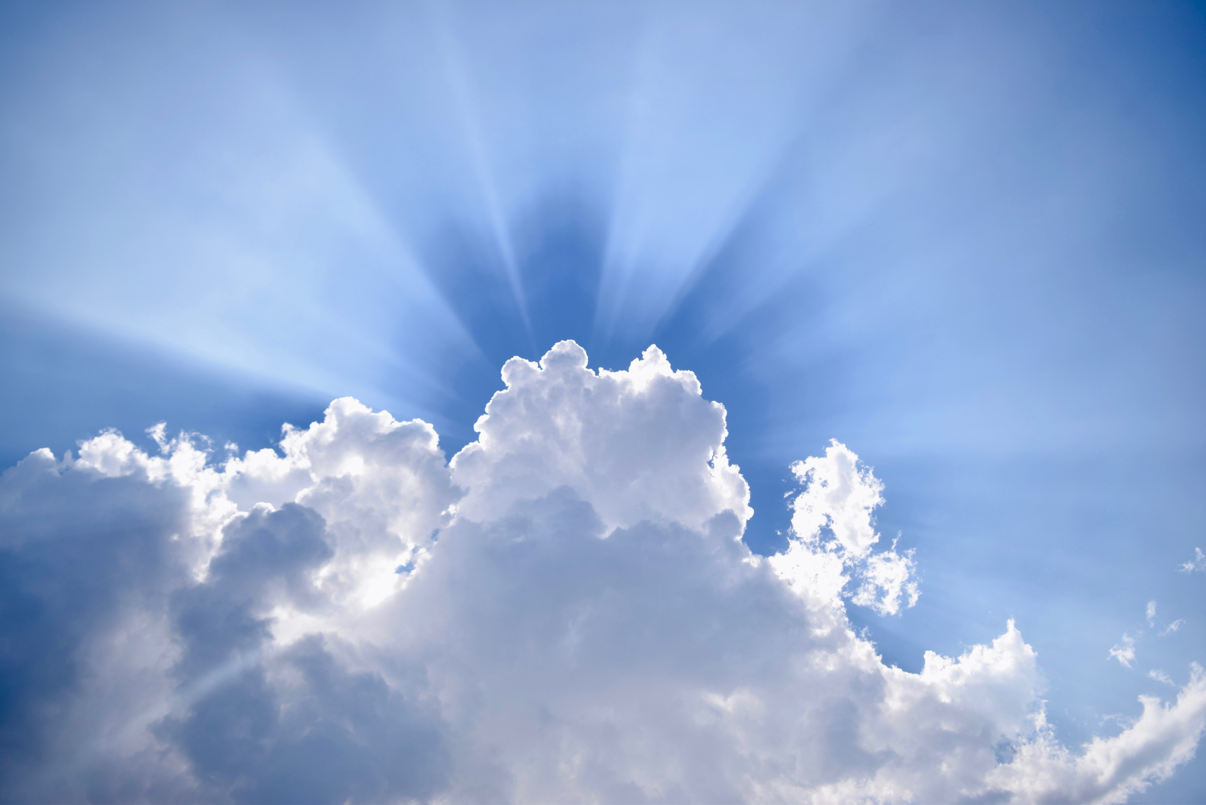
Mark 16
The Resurrection

Slide 2
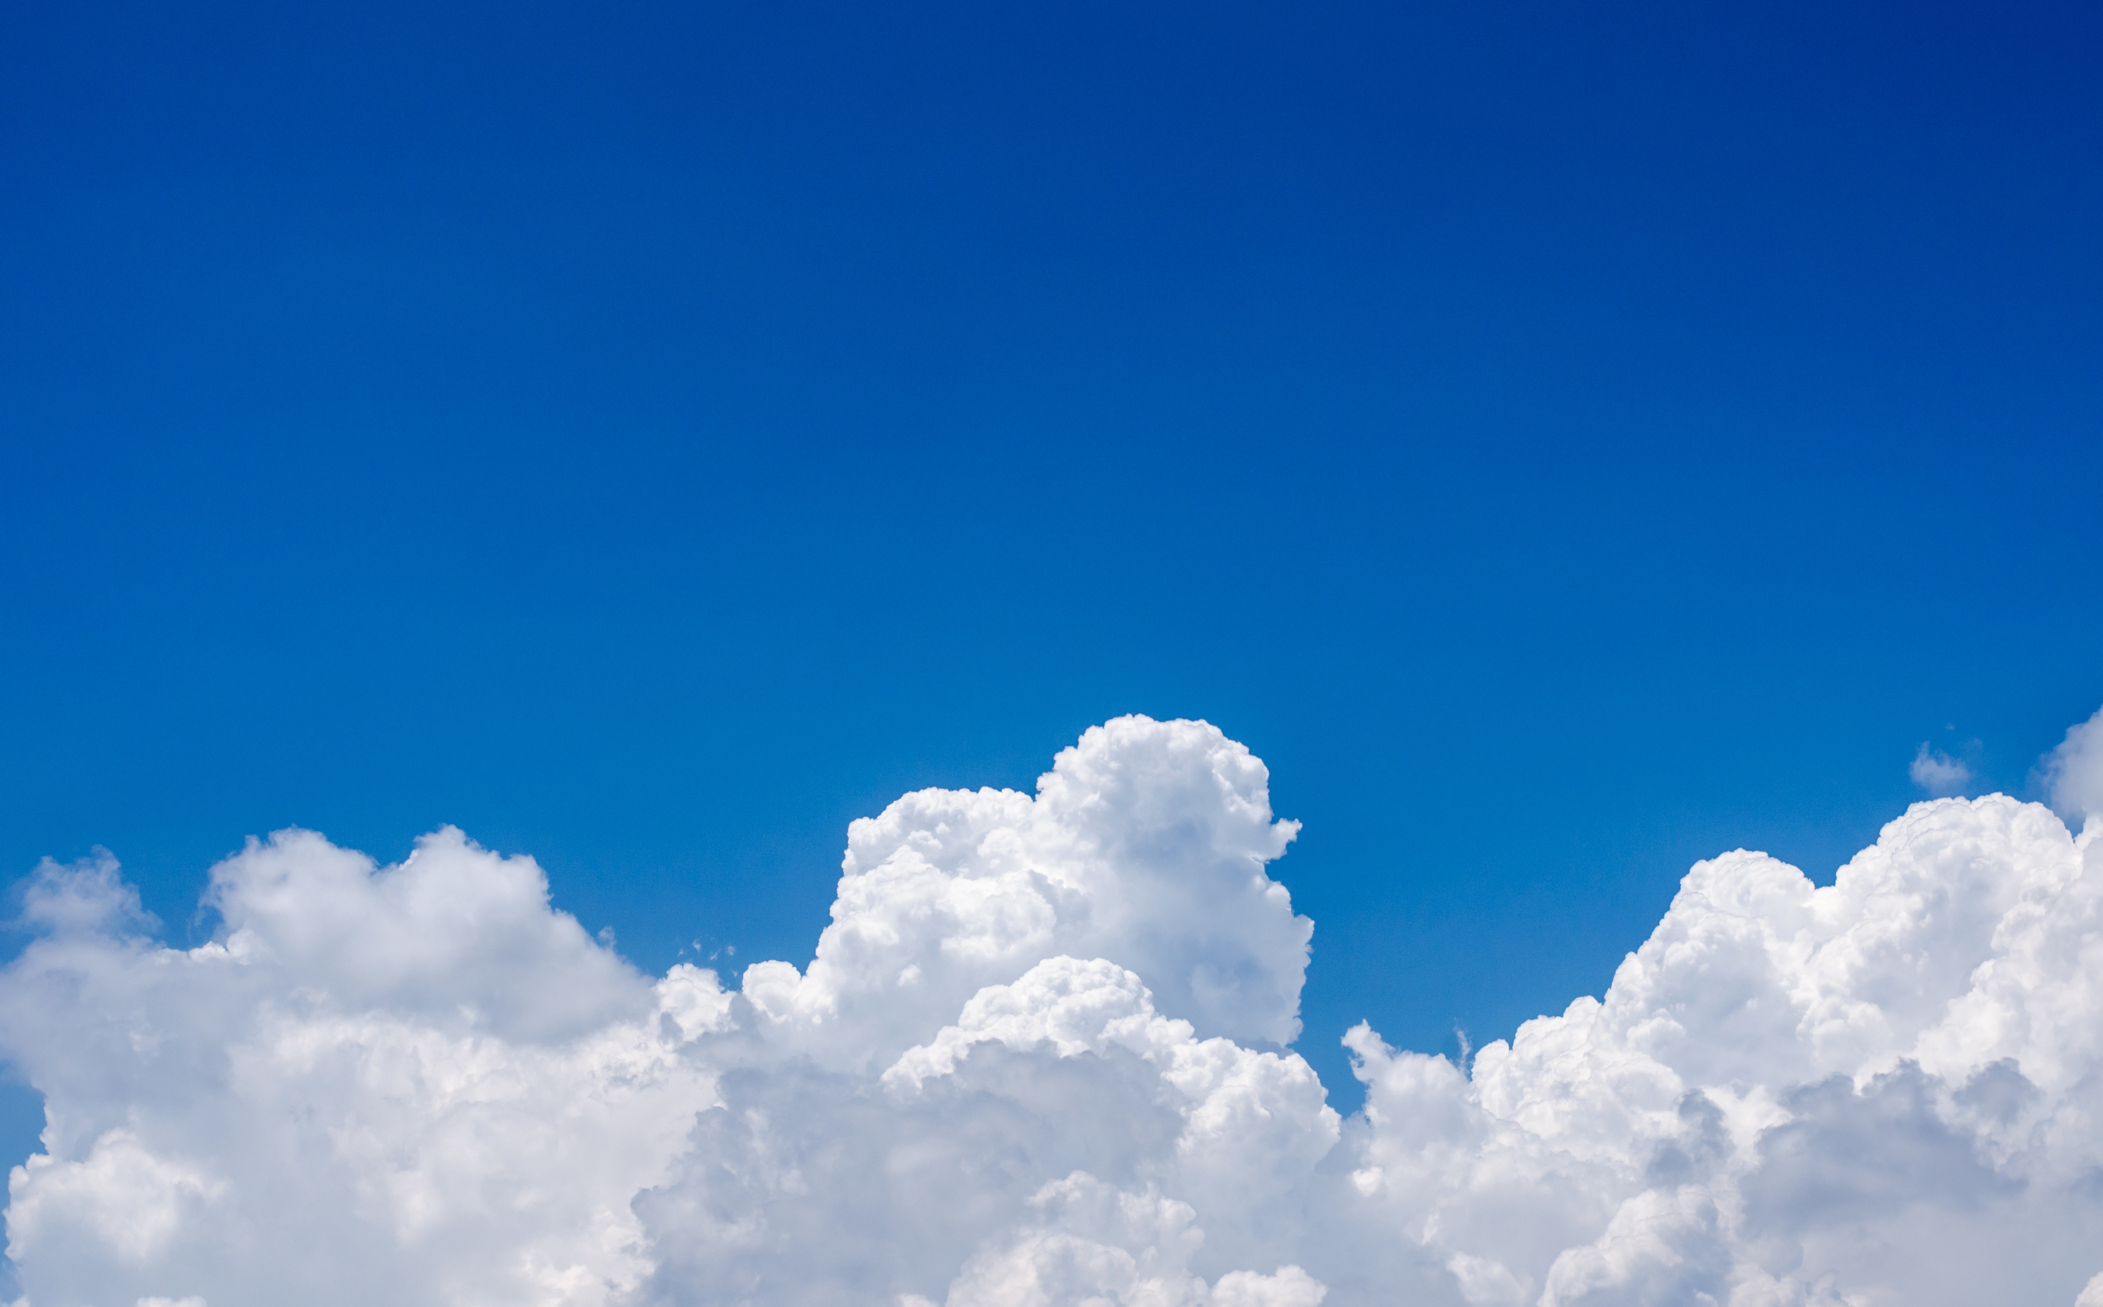
Main Highlight: He is Risen!
Go into all the world and preach the Good News to everyone! (Mark 16:2,15)

Slide 3
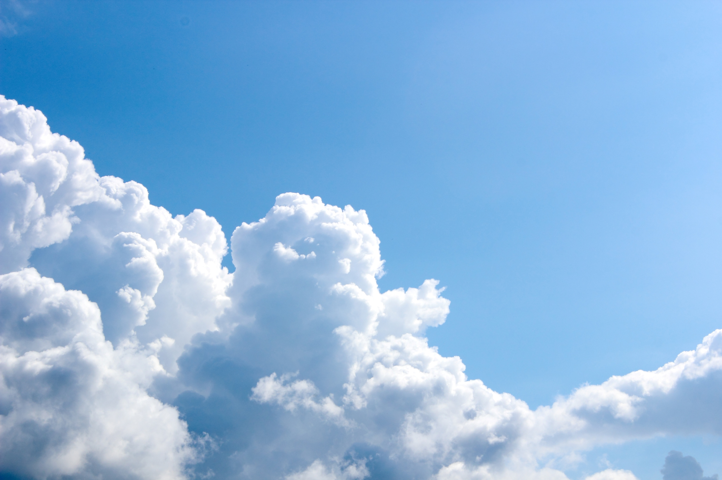
Mark 16:1-8
Main Message
Women went to tomb

Slide 4

Anoint Body
Matthew 26:6-10
John 11:2
John 19:38-39

Slide 5
Mark 16:9-20
Textual Criticism

Slide 6

Mark 16:9-11
Mary Magdalene
Response of those she told

Slide 7
Luke 8:1-3
Mary Magdalene provided for Jesus out of her substance

Slide 8

Mark 16:12-13
Jesus appeared different form
Response of those they told

Slide 9
Supernatural Presence
People Unaware
Hebrews 13:2

Slide 10

H
Mark 16:14-18
Jesus appears to disciples
Rebukes them for unbelief
Previous declarations

Slide 11
Ephesians 2:8-9
Romans 10-9-10
Romans 4:19-25
BELIEVE!

Slide 12
Mark 8:31
Mark 9:31
Mark 10:33-34
Previous
Declarations

Slide 13

Mark 16:19-20
Disciples obedient and faithful

Slide 14
Mark 16:15
Mark 16:20
Disciples’
Obedience

Slide 15
Gospel of Mark
Personal, impactful stories

